Slide 1
Java EE Training Course
Maven
Notes:
ATS Application Programming: Java Programming
Brown Bag: XML
© Accenture 2005 All Rights Reserved
Course Code #Z16325

Slide 2
Agenda
Maven overview
Maven artifacts
Maven POM
Maven plugins
Install Maven
Configuring Maven
Notes:
ATS Application Programming: Java Programming
Brown Bag: XML
© Accenture 2005 All Rights Reserved
Course Code #Z16325

Slide 3

What is Maven?
Apache Maven is a software project management and comprehension tool. Based on the concept of a project object model (POM), Maven can manage a project's build, reporting and documentation from a central piece of information.

Slide 4
Maven’s Objectives
There are several areas of concern that Maven attempts to deal with:
Making the build process easy
Providing a uniform build system
Providing quality project information
Providing guidelines for best practices development
Allowing transparent migration to new features
Notes:
Making the build process easy.
While using Maven doesn’t eliminate the need to know about the underlying mechanisms, Maven does provide a lot of shielding from the details.
Providing a uniform build system
Maven allows a project to build using its project object model (POM) and a set of plugins that are shared by all projects using Maven, providing a uniform build system. Once you familiarize yourself with how one Maven project builds you automatically know how all Maven projects build saving you immense amounts of time when trying to navigate many projects.
Providing quality project information
Maven provides plenty of useful project information that is in part taken from your POM and in part generated from your project’s sources.
Providing guidelines for best practices development
Maven aims to gather current principles for best practices development, and make it easy to guide a project in that direction. Examples:
- keeping your test source code in a separate, but parallel source tree
aims to assist in project workflow such as release management and issue tracking
suggests some guidelines on how to layout your project’s directory structure so that once you learn the layout you can easily navigate any other project that uses Maven and the same defaults
Allowing transparent migration to new features
Maven provides an easy way for Maven clients to update their installations so that they can take advantage of any changes that been made to Maven itself.
Installation of new or updated plugins from third parties or Maven itself has been made trivial for this reason.
ATS Application Programming: Java Programming
Brown Bag: XML
© Accenture 2005 All Rights Reserved
Course Code #Z16325

Slide 5
Glossary
There are some of the most common terms encountered while using Maven:
Project
Project Object Model (POM)
Artifact
GroupId
Dependency
Plug-in
Notes:
Project: Maven thinks in terms of projects. Everything that you will build are projects. Those projects follow a well defined “Project Object Model”. Projects can depend on other projects, in which case the latter are called “dependencies”. A project may consistent of several subprojects, however these subprojects are still treated equally as projects.
Project Object Model (POM): The Project Object Model, almost always referred as the POM for brevity, is the metadata that Maven needs to work with your project. Its name is “project.xml” and it is located in the root directory of each project.
Artifact: An artifact is something that is either produced or used by a project. Examples of artifacts produced by Maven for a project include: JARs, source and binary distributions, WARs. Each artifact is uniquely identified by a group id and an artifact ID which is unique within a group.
GroupId: A group ID is a universally unique identifier for a project. While this is often just the project name (eg. commons-collections), it is helpful to use a fully-qualified package name to distinguish it from other projects with a similar name (eg. org.apache.maven).
Dependency: A typical Java project relies on libraries to build and/or run. Those are called “dependencies” inside Maven. Those dependencies are usually other projects’ JAR artifacts, but are referenced by the POM that describes them.
Plug-in: Maven is organized in plugins. Every piece of functionality in Maven is provided by a plugin. Plugins provide goals and use the metadata found in the POM to perform their task. Examples of plugins are: jar, eclipse, war. Plugins are primarily written in Java, but Maven also supports writing plug-ins in Beanshell and Ant Scripting
ATS Application Programming: Java Programming
Brown Bag: XML
© Accenture 2005 All Rights Reserved
Course Code #Z16325

Slide 6
What is Archetype?
Archetype is a Maven project templating toolkit
Creating new project based on an Archetype:
  mvn archetype:generate -DgroupId=com.company -DartifactId=web-app -DarchetypeArtifactId=maven-archetype-webapp
Maven provides several Archetype artifacts:
maven-archetype-simple
maven-archetype-webapp
Notes:
An archetype is defined as an original pattern or model from which all other things of the same kind are made
Custom archetypes
ATS Application Programming: Java Programming
Brown Bag: XML
© Accenture 2005 All Rights Reserved
Course Code #Z16325

Slide 7
Repository
A repository in Maven is used to hold build artifacts and dependencies of varying types.
There are strictly only two types of repositories: local and remote.
Remote repositories refer to any other type of repository, accessed by a variety of protocols such as file:// and http://.
Examples Maven's central repository:
repo.maven.apache.org
uk.maven.org
Notes:
The local repository refers to a copy on your own installation that is a cache of the remote downloads, and also contains the temporary build artifacts that you have not yet released.
These repositories might be a truly remote repository set up by a third party to provide their artifacts for downloading. Other "remote" repositories may be internal repositories set up on a file or HTTP server within your company, used to share private artifacts between development teams and for releases.
ATS Application Programming: Java Programming
Brown Bag: XML
© Accenture 2005 All Rights Reserved
Course Code #Z16325

Slide 8
Introduction to the POM
A Project Object Model or POM is the fundamental unit of work in Maven.
It is an XML file that contains information about the project and configuration details used by Maven to build the project.
It contains default values for most projects.
The Super POM is Maven's default POM.
Notes:
It contains default values for most projects. Examples for this is the build directory, which is target; the source directory, which is src/main/java; the test source directory, which is src/test/java; and so on.
All POMs extend the Super POM unless explicitly set, meaning the configuration specified in the Super POM is inherited by the POMs you created for your projects.
ATS Application Programming: Java Programming
Brown Bag: XML
© Accenture 2005 All Rights Reserved
Course Code #Z16325

Slide 9
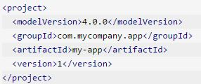
Minimal POM
The minimum requirement for a POM are the following:
project root
modelVersion - should be set to 4.0.0
groupId - the id of the project's group.
artifactId - the id of the artifact (project)
version - the version of the artifact under the specified group
Notes:
A POM requires that its groupId, artifactId, and version be configured. These three values form the project's fully qualified artifact name. This is in the form of <groupId>:<artifactId>:<version>. As for the example above, its fully qualified artifact name is "com.mycompany.app:my-app:1".
Also, as mentioned in the first section, if the configuration details are not specified, Maven will use their defaults. One of these default values is the packaging type. Every Maven project has a packaging type. If it is not specified in the POM, then the default value "jar" would be used.
In the minimal POM, the repositories were not specified. If you build your project using the minimal POM, it would inherit the repositories configuration in the Super POM. Therefore when Maven sees the dependencies in the minimal POM, it would know that these dependencies will be downloaded from http://repo.maven.apache.org/maven2 which was specified in the Super POM.
ATS Application Programming: Java Programming
Brown Bag: XML
© Accenture 2005 All Rights Reserved
Course Code #Z16325

Slide 10
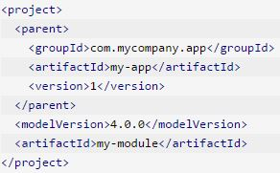
Project Inheritance
Elements in the POM that are merged are the following:
dependencies
developers and contributors
plugin lists (including reports)
plugin executions with matching ids
plugin configuration
resources
Notes:
The Super POM is one example of project inheritance, however you can also introduce your own parent POMs by specifying the parent element in the POM, as demonstrated in the following examples.
ATS Application Programming: Java Programming
Brown Bag: XML
© Accenture 2005 All Rights Reserved
Course Code #Z16325

Slide 11
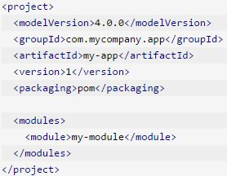
Project Aggregation
It specifies the modules from the parent POM
The parent project now knows its modules
To do Project Aggregation, you must do the following:
Change the parent POMs packaging to the value "pom" .
Specify in the parent POM the directories of its modules (children POMs)
Notes:
Project Aggregation is similar to Project Inheritance. But instead of specifying the parent POM from the module, it specifies the modules from the parent POM. By doing so, the parent project now knows its modules, and if a Maven command is invoked against the parent project, that Maven command will then be executed to the parent's modules as well.
In the revised com.mycompany.app:my-app:1, the packaging section and the modules sections were added. For the packaging, its value was set to "pom", and for the modules section, we have the element <module>my-module</module>. The value of <module> is the relative path from the com.mycompany.app:my-app:1 to com.mycompany.app:my-module:1's POM (by practice, we use the module's artifactId as the module directory's name).
ATS Application Programming: Java Programming
Brown Bag: XML
© Accenture 2005 All Rights Reserved
Course Code #Z16325

Slide 12
Project Inheritance vs Project Aggregation
If you have several Maven projects, and they all have similar configurations, you can refactor your projects by pulling out those similar configurations and making a parent project.
If you have a group of projects that are built or processed together, you can create a parent project and have that parent project declare those projects as its modules.
You'd just have to apply all three rules:
Specify in every child POM who their parent POM is.
Change the parent POMs packaging to the value "pom" .
Specify in the parent POM the directories of its modules (children POMs)
Notes:
Project Inheritance. Thus, all you have to do is to let your Maven projects inherit that parent project, and those configurations would then be applied to all of them.
Project Aggregation. By doing so, you'd only have to build the parent and the rest will follow.
You can have both Project Inheritance and Project Aggregation. Meaning, you can have your modules specify a parent project, and at the same time, have that parent project specify those Maven projects as its modules.
ATS Application Programming: Java Programming
Brown Bag: XML
© Accenture 2005 All Rights Reserved
Course Code #Z16325

Slide 13
Variables
Maven allows you to use both your own and pre-defined variables in the POM.
For example, to access the project.version variable, you would reference it like so:
<version>${project.version}</version>
Any field of the model that is a single value element can be referenced as a variable.
For example, ${project.groupId}, ${project.version}, ${project.build.sourceDirectory} and so on.
You are also able to reference any properties defined in the project as a variable.
Notes:
One of the practices that Maven encourages is don't repeat yourself. However, there are circumstances where you will need to use the same value in several different locations. To assist in ensuring the value is only specified once, Maven allows you to use both your own and pre-defined variables in the POM.
ATS Application Programming: Java Programming
Brown Bag: XML
© Accenture 2005 All Rights Reserved
Course Code #Z16325

Slide 14
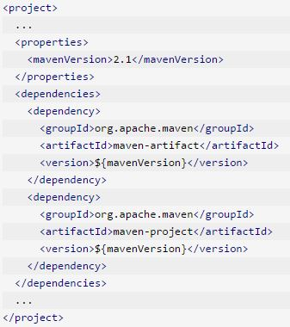
Custom properties in the POM
You are also able to reference any properties defined in the project as a variable.

Slide 15
Introduction to the Build Lifecycle
Maven is based around the central concept of a build lifecycle.
There are three built-in build lifecycles:
default lifecycle handles your project deployment
clean lifecycle handles project cleaning
site lifecycle handles the creation of your project's site documentation.
Each of these build lifecycles is defined by a different list of build phases, wherein a build phase represents a stage in the lifecycle.
Notes:
Default, clean, site – фазы сборки. Они не выполняются, если специально не указаны в строке запуска.
ATS Application Programming: Java Programming
Brown Bag: XML
© Accenture 2005 All Rights Reserved
Course Code #Z16325

Slide 16
The default lifecycle
Phase | Description
validate | Validate the project is correct and all necessary information is available
compile | Compile the source code of the project
test | Test the compiled source code using a suitable unit testing framework
package | Take the compiled code and package it in its distributable format, such as a JAR
verify | Run any checks on results of integration tests to ensure quality criteria are met
install | Install the package into the local repository, for use as a dependency in other projects locally
deploy | Done in the build environment, copies the final package to the remote repository for sharing with other developers and projects
Notes:
These lifecycle phases (plus the other lifecycle phases not shown here) are executed sequentially to complete the default lifecycle.
Given the lifecycle phases above, this means that when the default lifecycle is used, Maven will first validate the project, then will try to compile the sources, run those against the tests, package the binaries (e.g. jar), run integration tests against that package, verify the integration tests, install the verified package to the local repository, then deploy the installed package to a remote repository.
ATS Application Programming: Java Programming
Brown Bag: XML
© Accenture 2005 All Rights Reserved
Course Code #Z16325

Slide 17
Usual Command Line Calls
In a development environment, use the following call to build and install artifacts into the local repository:
mvn install
In a build environment, use the following call to cleanly build and deploy artifacts into the shared repository.
mvn clean deploy
Notes:
This command executes each default life cycle phase in order (validate, compile, package, etc.), before executing install. You only need to call the last build phase to be executed, in this case, install.
The same command can be used in a multi-module scenario (i.e. a project with one or more subprojects). Maven traverses into every subproject and executes clean, then executes deploy (including all of the prior build phase steps).
ATS Application Programming: Java Programming
Brown Bag: XML
© Accenture 2005 All Rights Reserved
Course Code #Z16325

Slide 18
Plugins
Maven is a plugin execution framework.
Plugins are artifacts that provide goals to Maven.
There are the build and the reporting plugins:
Build plugins will be executed during the build and they should be configured in the <build/> element from the POM.
Reporting plugins will be executed during the site generation and they should be configured in the <reporting/> element from the POM.
Notes:
http://maven.apache.org/plugins/index.html
ATS Application Programming: Java Programming
Brown Bag: XML
© Accenture 2005 All Rights Reserved
Course Code #Z16325

Slide 19
A Build Phase is Made Up of Plugin Goals
A plugin goal represents a specific task which contributes to the building and managing of a project.
A goal not bound to any build phase could be executed outside of the build lifecycle by direct invocation.
The order of execution depends on the order in which the goal(s) and the build phase(s) are invoked.
For example:
mvn clean dependency:copy-dependencies package
Notes:
However, even though a build phase is responsible for a specific step in the build lifecycle, the manner in which it carries out those responsibilities may vary. And this is done by declaring the plugin goals bound to those build phases.
For example: The clean and package arguments are build phases, while the dependency:copy-dependencies is a goal (of a plugin).
If this were to be executed, the clean phase will be executed first (meaning it will run all preceding phases of the clean lifecycle, plus the clean phase itself), and then the dependency:copy-dependencies goal, before finally executing the package phase (and all its preceding build phases of the default lifecycle).
ATS Application Programming: Java Programming
Brown Bag: XML
© Accenture 2005 All Rights Reserved
Course Code #Z16325

Slide 20
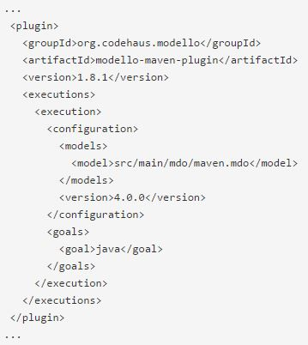
Configure plugins to add goals
The second way to add goals to phases is to configure plugins in your project.

Slide 21
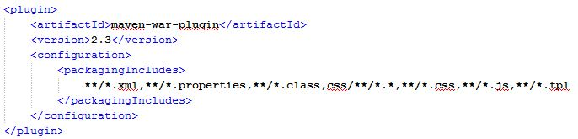
Apache Maven WAR Plugin
It builds a WAR file.
Goal war:war is the default goal invoked during the package phase for projects with a packaging type of war.
When using the war: goals it is assumed that the compile phase is already done.
Notes:
The WAR Plugin is responsible for collecting all artifact dependencies, classes and resources of the web application and packaging them into a web application archive.
Using the package phase with the project package type as war / invocation of the war:war goal.
ATS Application Programming: Java Programming
Brown Bag: XML
© Accenture 2005 All Rights Reserved
Course Code #Z16325

Slide 22
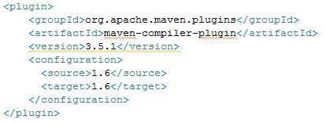
Apache Maven Compiler Plugin
The Compiler Plugin is used to compile the sources of your project.
Goal compiler:compile is bound to the compile phase and is used to compile the main source files.

Slide 23
Install Maven
The installation of Apache Maven is a simple process of extracting the archive and adding the bin folder with the mvn command to the PATH:
Ensure JAVA_HOME environment variable is set and points to your JDK installation.
Extract distribution archive in any directory
Add the unpacked distribution’s bin directory to your user PATH environment variable
Open a new command prompt and run mvn -v to verify the installation

Slide 24
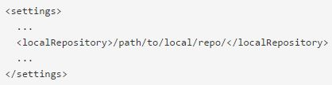
Configuring your Local Repository
The location of your local repository can be changed in your user configuration.
The default value is ${user.home}/.m2/repository/.

Slide 25
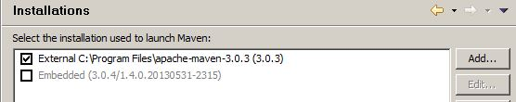
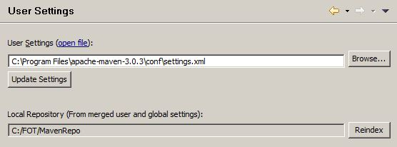
Configuring Maven for Eclispe
Change installations
Change user settings

Slide 26

Questions and Commnets

Slide 27
Module 2 Activity. Part 1
Download apache-maven-3.3.9-bin.zip from https://maven.apache.org/download.cgi
Extract distribution archive in directory C:\Program Files
Check environment variable value JAVA_HOME
Set Maven environment variables:
M2_HOME = C:\Program Files\apache-maven-3.3.9
M2 = %M2_HOME%\bin
Append the string ;%M2% to the end of the system variable Path
Verify Maven installation of command mvn –version
For Eclipse:
Select the installation used to launch Maven (Preferences -> Maven -> Installations)
Notes:
ATS Application Programming: Java Programming
Brown Bag: XML
© Accenture 2005 All Rights Reserved
Course Code #Z16325

Slide 28
Module 2 Activity. Part 2
Create maven project:
  archetype - maven-archetype-webapp
  groupId - com.accenture
  artifactId – flowershop
  packaging – war
  version - 0.0.1
Plug in apache-maven-compiler plugin and set version JVM for compilation source code
Build project and check your war artifact in your local repository
Deploy artifact on application server with IDE

